Slide 1
Back to the Future of Music
Team 11
Eric Bennett, Casey Montgomery, Charles Staffeld, James Solonika
Ver. 1.2

Slide 2
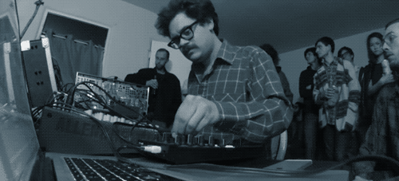

Seeing an electronic musician perform is usually pretty boring
Notes:
Electronic music is boring to watch, all the actions are small (knob twist, button pushes, ect)

Slide 3

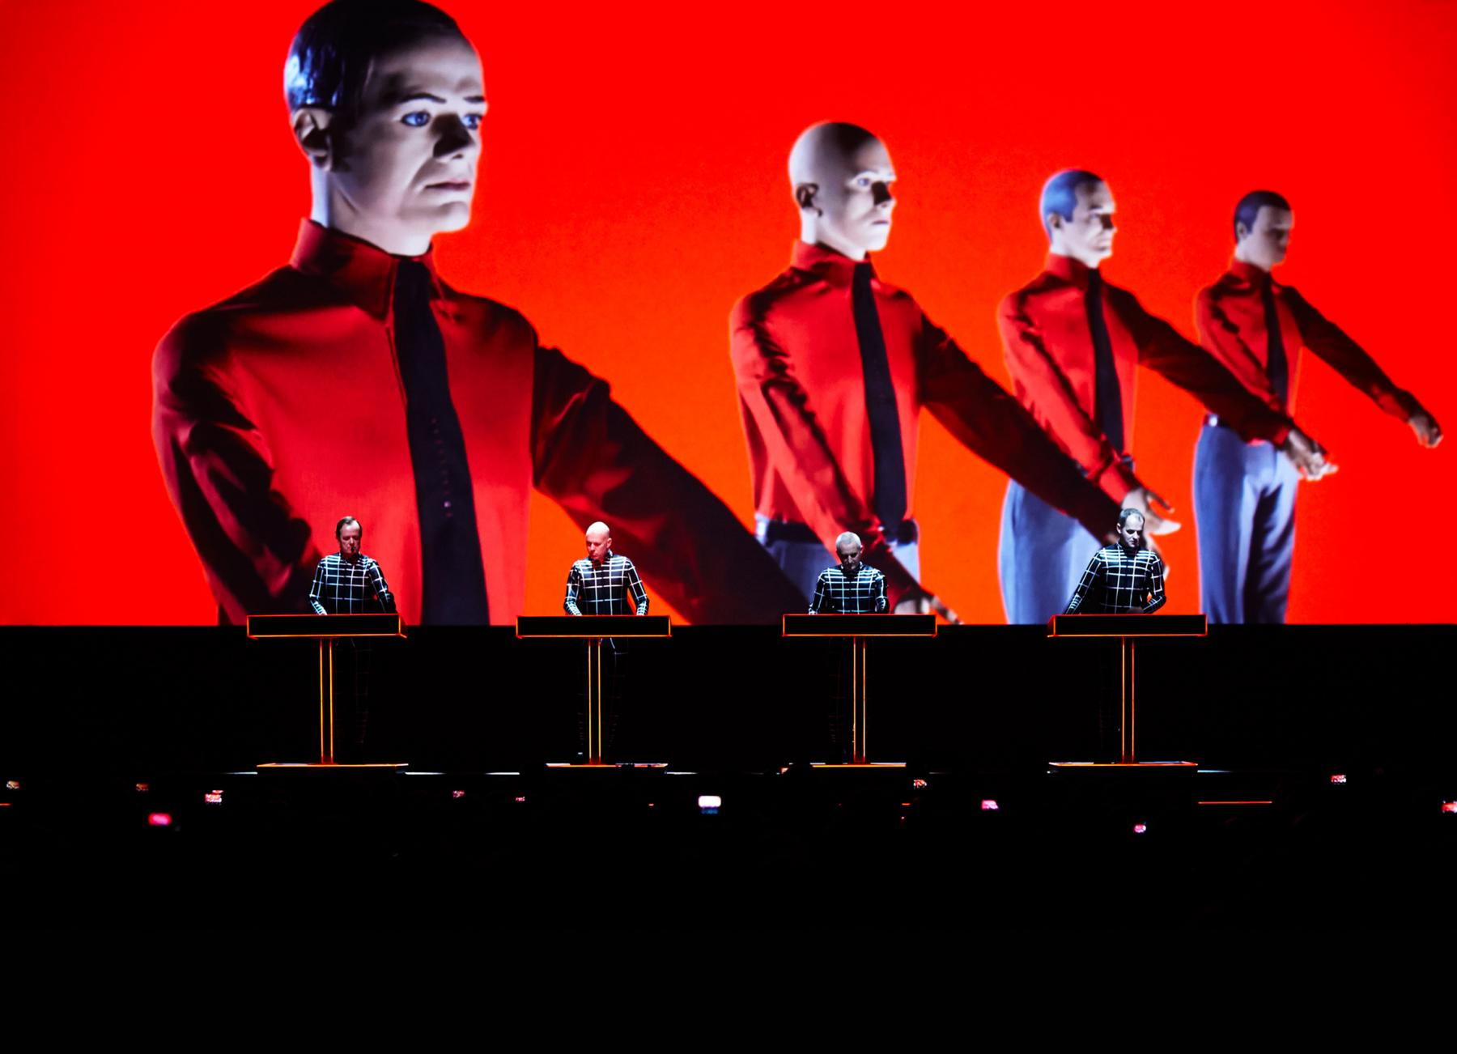
Successful electronic musicians find ways to be more entertaining
Notes:
Succesful musicians find a way to to make their instruments and performance more expressive and physical

Slide 4
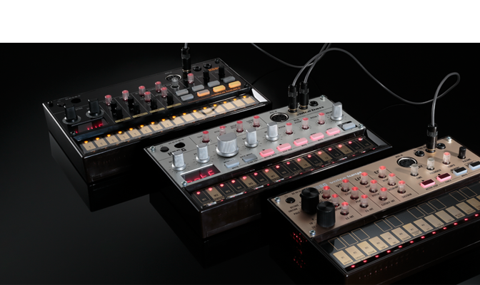



Notes:
Legacy analog instruments are popular again!

Slide 5
Motivation
An electronic musical instrument that is more expressive than traditional knobs and buttons, but also taps into the legacy of electronic music equipment could be a great way to enter the market
Notes:
We’re setting up why we why a company would want to get a product for this market

Slide 6
Our Mission
Prototype a musical instrument which is more expressive, has modern interfaces, and incorporates some aspects of legacy analog instruments
Notes:
This is our specific play for this project. What we want to achieve with our project

Slide 7
Requirements
Need
Modern, simple design.
Intuitive interface which is simple enough for a novice musician to figure out in less than 10 minutes.
Connect to modern musical instruments through commonly used cables and protocols.
(performative) Control musical instruments by movement of hand/body, allow for large motions
Function in noisy environments (like on a stage in a concert).
Be able to garner some credibility among electronic music geeks.
Should
Provide user feedback.
May
Can be dropped from 2 feet and survive.
Connect to and control non-musical devices, such as lighting controls.
Notes:
These are the requirements we, generated for our prototype, in order to fit into the niche we outline in the beginning of the presentation

Slide 8
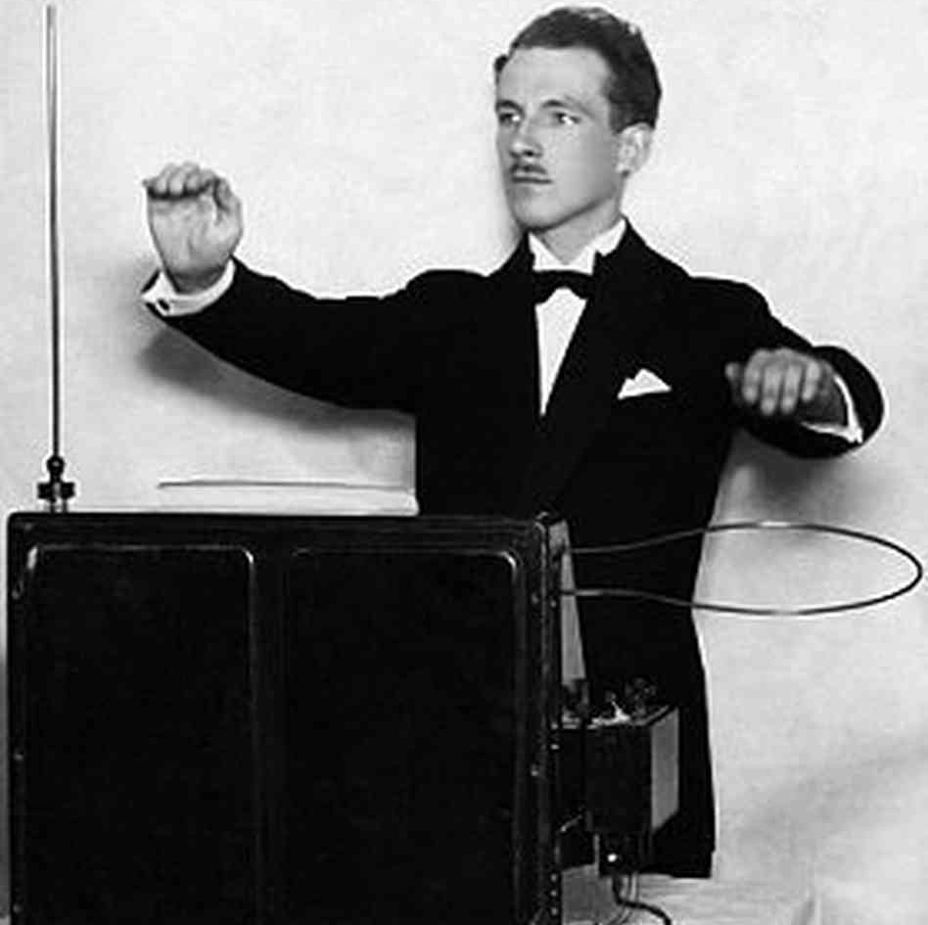
TEAM 11
THE MIDI THEREMIN

Slide 9
Inductive Proximity MIDI Controller
VS
MIDI THEREMIN
Hey, wait, I thought you guys were ...
Notes:
This is where we talk about how we derisked the inductive proximity sensor and found it didn’t work well. This led us to a capacative sensor, which is how a theremin works.

Slide 10
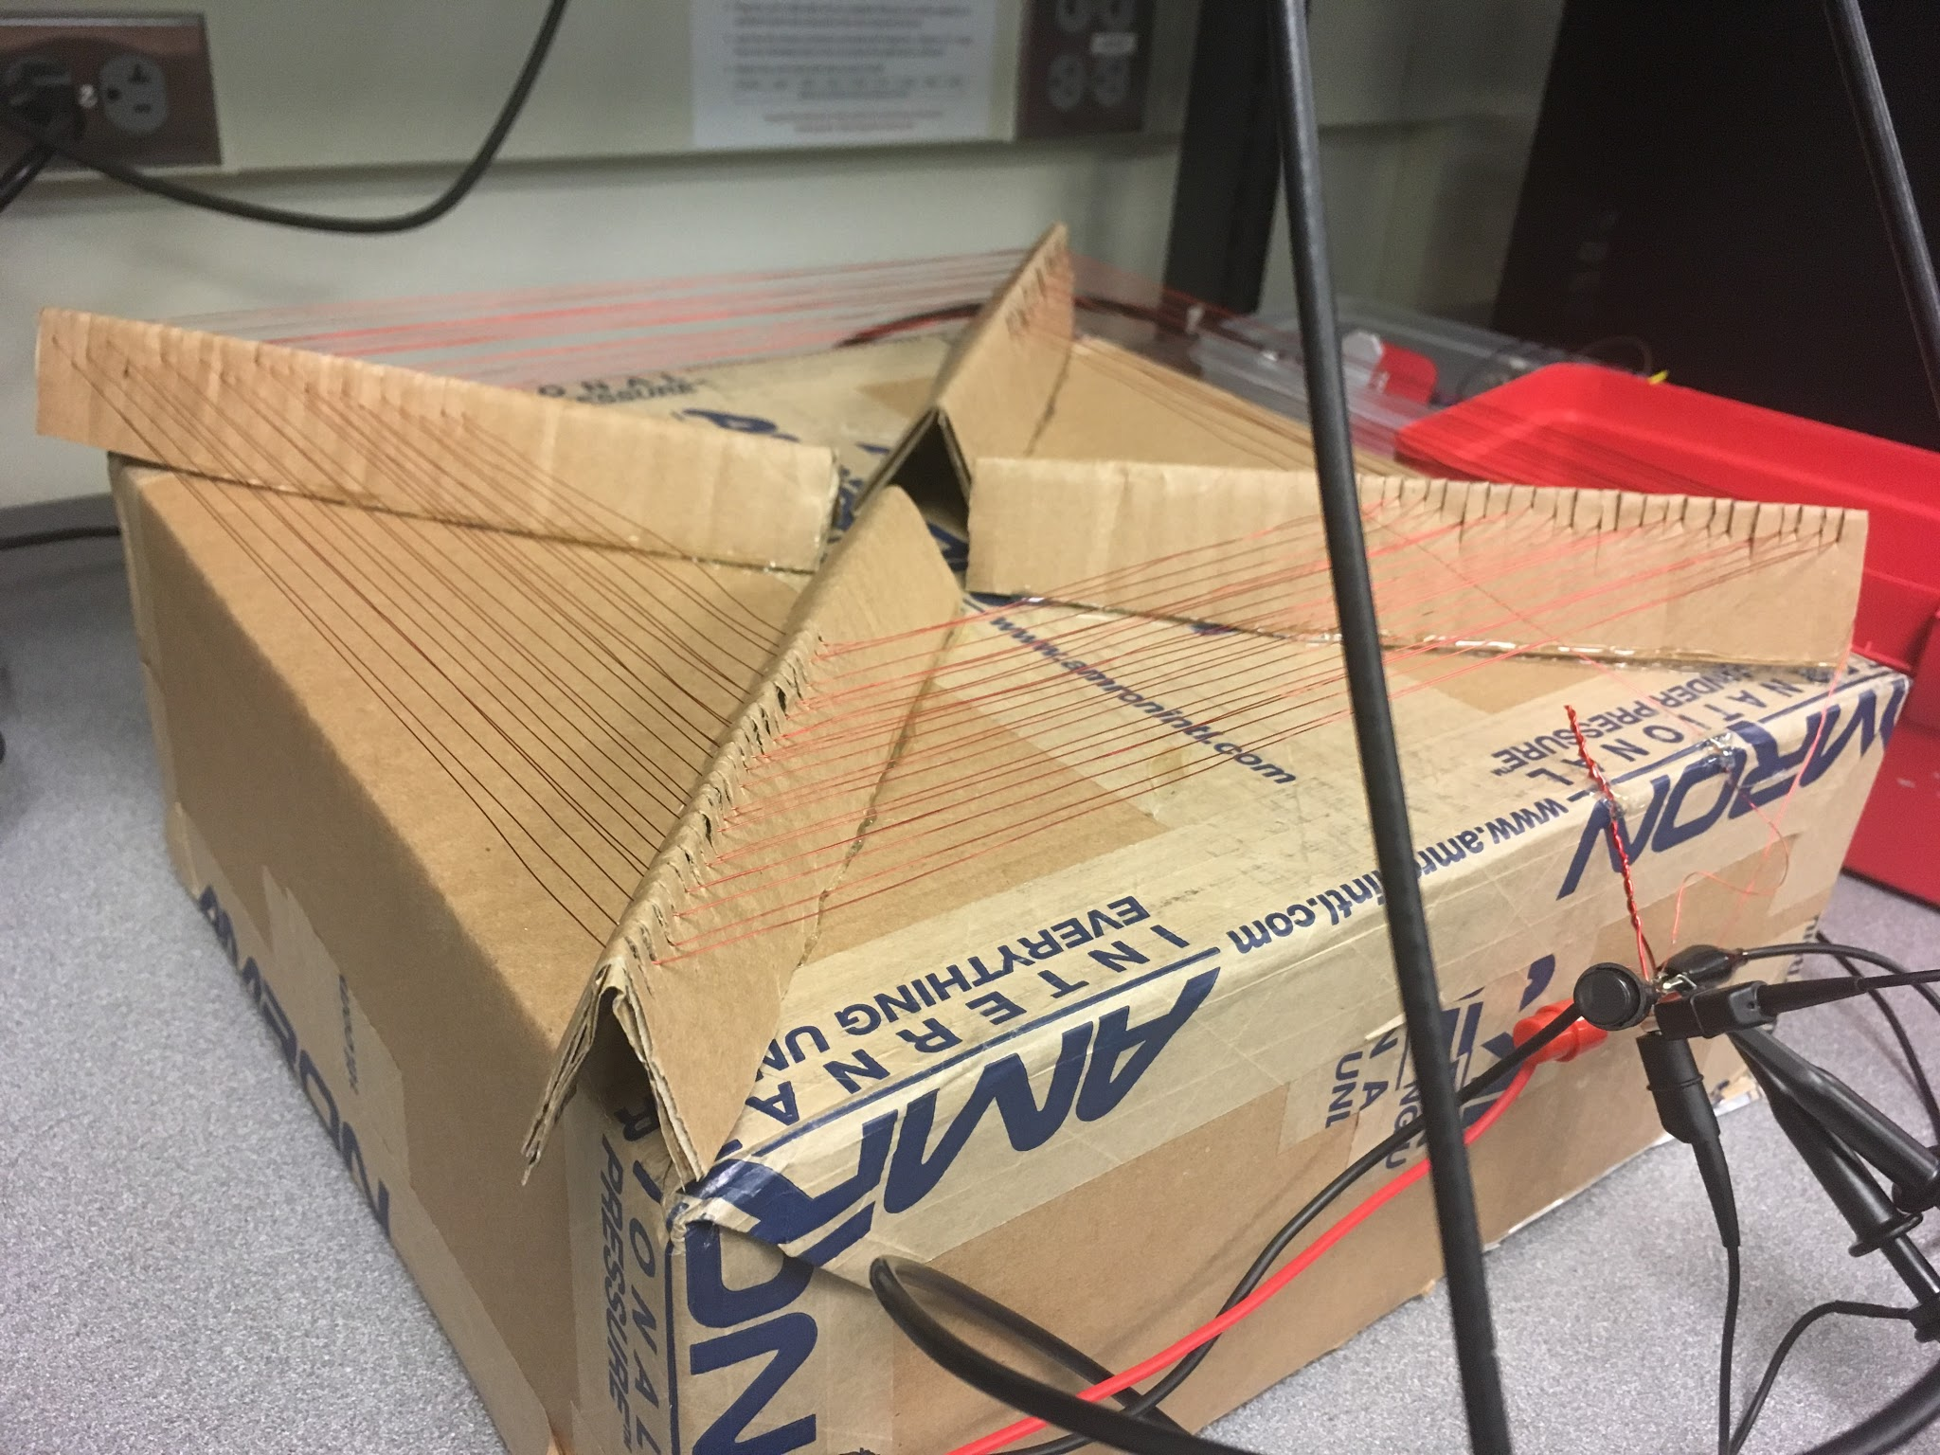
This giant flat coil inductor (about 12” square) gave us about 3 inches of dynamic control!
Notes:
Early de-risking threw “inductive” out the window.

Slide 11
Engineering Requirements
Functionality
Robust sensor inputs - minimal to no manual calibration required after initial build.
MIDI compatible outputs.
Allow automatic environmental calibration.
Allow user settable sensor MIDI mapping to more instrument parameters
Performance
Be able to sense physical motion up to 3 feet away from the sensor.
Health & Safety
Keep voltage and current levels safe for human contact.
Make sure all exposed edges and corners are not sharp enough to cut human skin.

Slide 12
Engineering Requirements
Legal
Comply with FCC frequency regulations. (don’t generate a bunch of EM noise)
Operational
Portable and easy to set up - should not require more than one person.
Social and Cultural
Capitalize on the legacy of analog music equipment.

Slide 13
Engineering Requirements
Marketing Requirements | Engineering requirements | Justification
3,4 | Run on 12V DC power | Easy to obtain a barrel jack plug for
1 | Oscillators should have a stable resting frequency (within 1 kHz of target frequency) | Minimizes time to calibrate and amount of calibrations required
3,4 | Power sensor boards through MIDI cable from CPU board | Simplifies device setup and reduces overall size of the system
2, 5 | Use an antenna that extends beyond the board and can be swapped out if needed | Aids in sensor strength and allows changes to antenna based on testing
Marketing requirements Minimal calibration Sense within three feet Portable and easy to set up Low energy Capitalize on the legacy of analog music equipment
Notes:
We might kill this slide.

Slide 14
Our Approach
Begin with a basic theremin circuit,
but instead of using the frequency it generates directly,
convert it to data in order to increase the capabilities of the instrument and interface with modern electronic instruments.

Slide 15
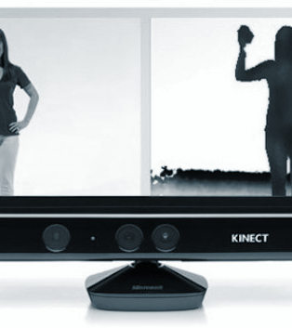
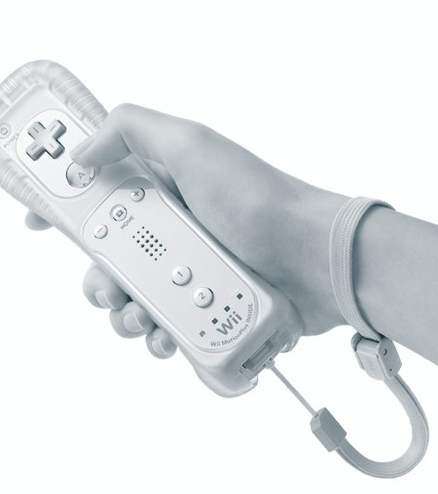
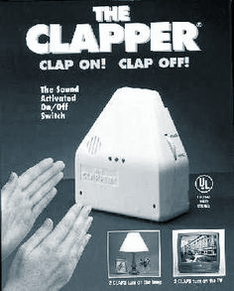
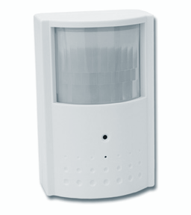
Why didn’t we sense proximity with one of these?
Notes:
Why we didn’t use these alternatives.
Legacy: a theremin is cool - has a history.
Issues with lighting effecting optical sensors.
Ultrasonic sensors can be slow and respond to loud noises.

Slide 16
THE DESIGN
How Does it work?

Slide 17
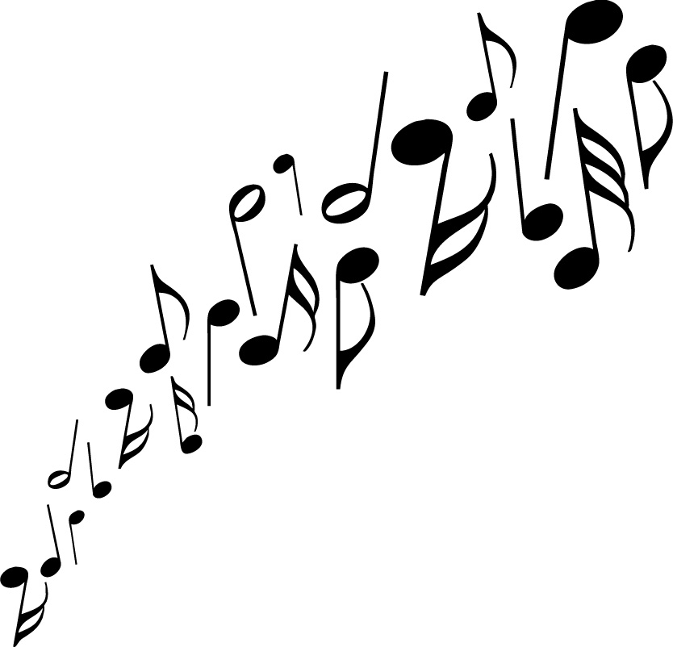


Big Picture MIDI Theremin Operation
Theremin
Proximity Sensor
Sensor CPU Hub
Theremin Proximity Sensor
Performer's Hand
MIDI OUTPUT
Theremin Proximity
Sensor
Electronic Synthesizer or other MIDI capable device

Slide 18
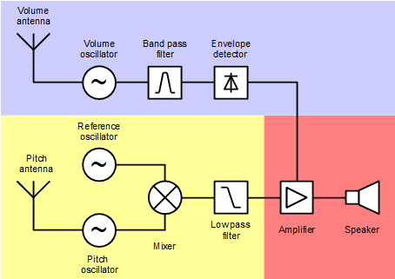
Classic Theremin Circuit

Slide 19
Our Theremin Sensor
Voltage Controlled
local Oscillator
Analog Calibration Signal
Frequency to voltage
converter
Analog Proximity Signal

Slide 20
Sensor CPU Hub
Microcontroller
Theremin Proximity
Sensor
Analog Calibration Signal
Low Pass Filter
PWM
Analog Proximity Signal
ADC
Sensor CPU
Hub
MIDI
Tx
Notes:
Our CPU block diagram

Slide 21
Calibration Mode
5 volts
Towards Antenna
Analog Proximity Signal
0 volts
Antenna Freq << Ref Freq
Antenna Freq = Ref Freq
Antenna Freq >> Ref Freq
Calibration Sets Resting Voltage Here

Slide 22
Pitch Change Mode
Sensor
Sensor
ADC
ADC
Average
Velocity
Average
if(prevPitch != newPitch){
Get velocity
Turn off previous MIDI Note
Send new MIDI Note % Velocity
Save prevPitch
}
MIDI OUTPUT
Logerize
Pitch Event

Slide 23
Gate Trigger Mode
Sensor
Sensor
ADC
ADC
Average
Logerize
Pitch
Average
if(PlayState is off && GateTrigger is on)
Set playState on
Get new pitch value
MidiNoteOn(pitch);
If (playState is off && gateTrigger is off)
Set playState off
MidiNoteOff(prevPitch);
Threshold
Comparator
Gate Trigger Event
MIDI OUTPUT

Slide 24

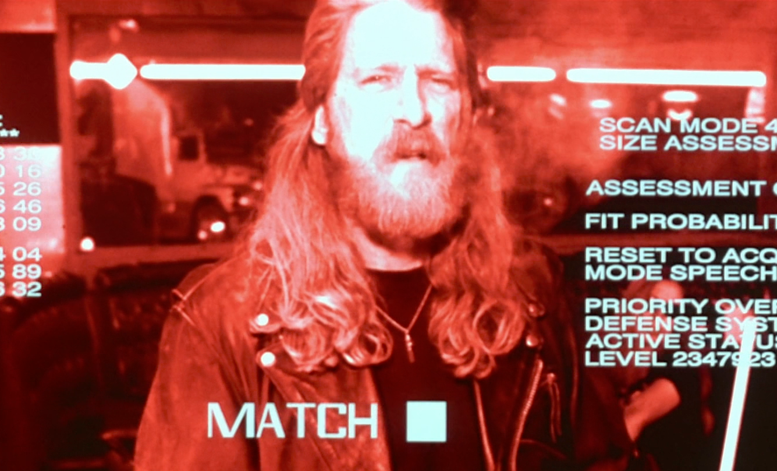
Hardware
Implementation
Software
Implementation
Sensor schematic and PCB design
Sensor Hub schematic and PCB design
Mode Menu Navigation
Calibration
Mode Functionality

Slide 25
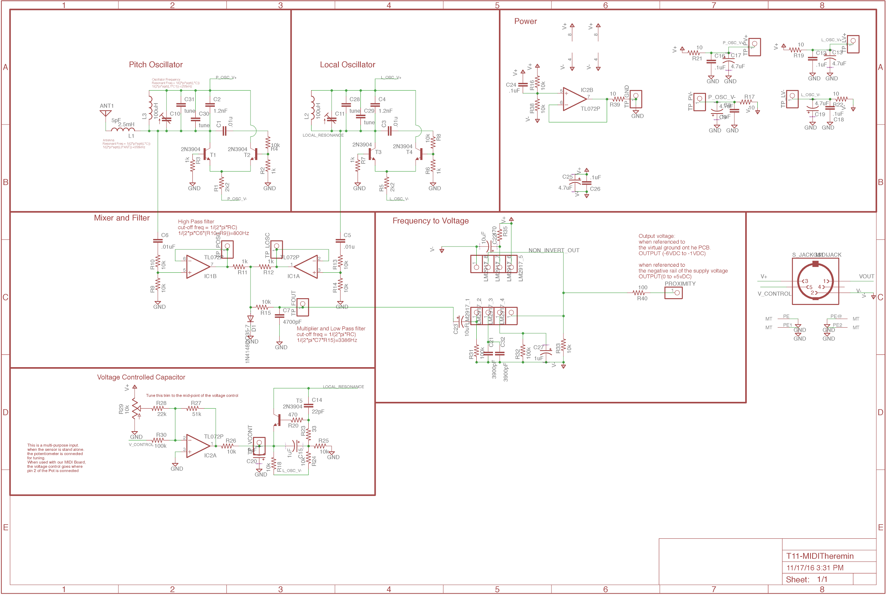
Notes:
You can pretty much map each section of this schematic back to the block diagram I showed you earlier

Slide 26
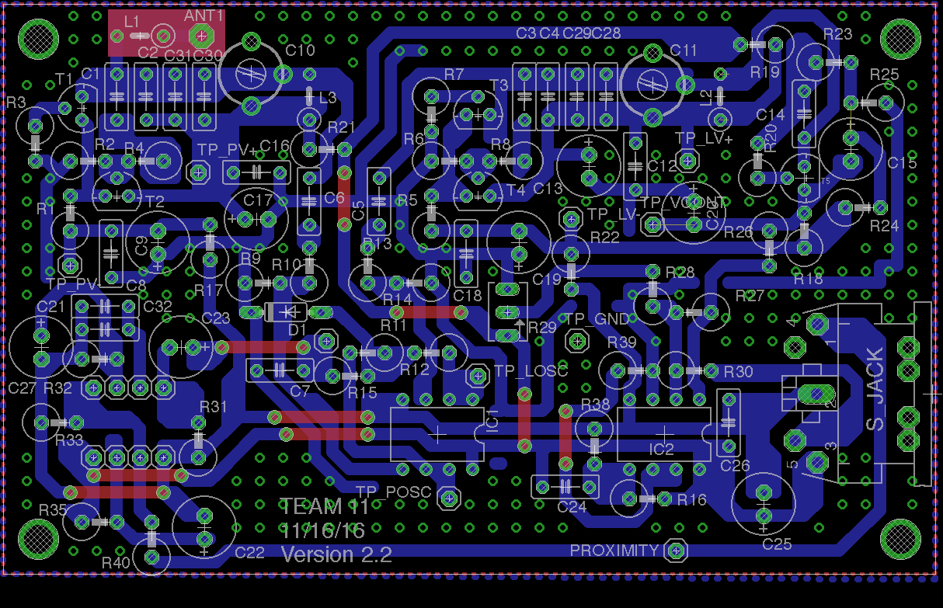
Notes:
Notice: this board has fat traces and they are almost entirely on one side. This is because we wanted to get a prototype of this board going early to de-risk, so we did a version that would be easy to etch.

Slide 27
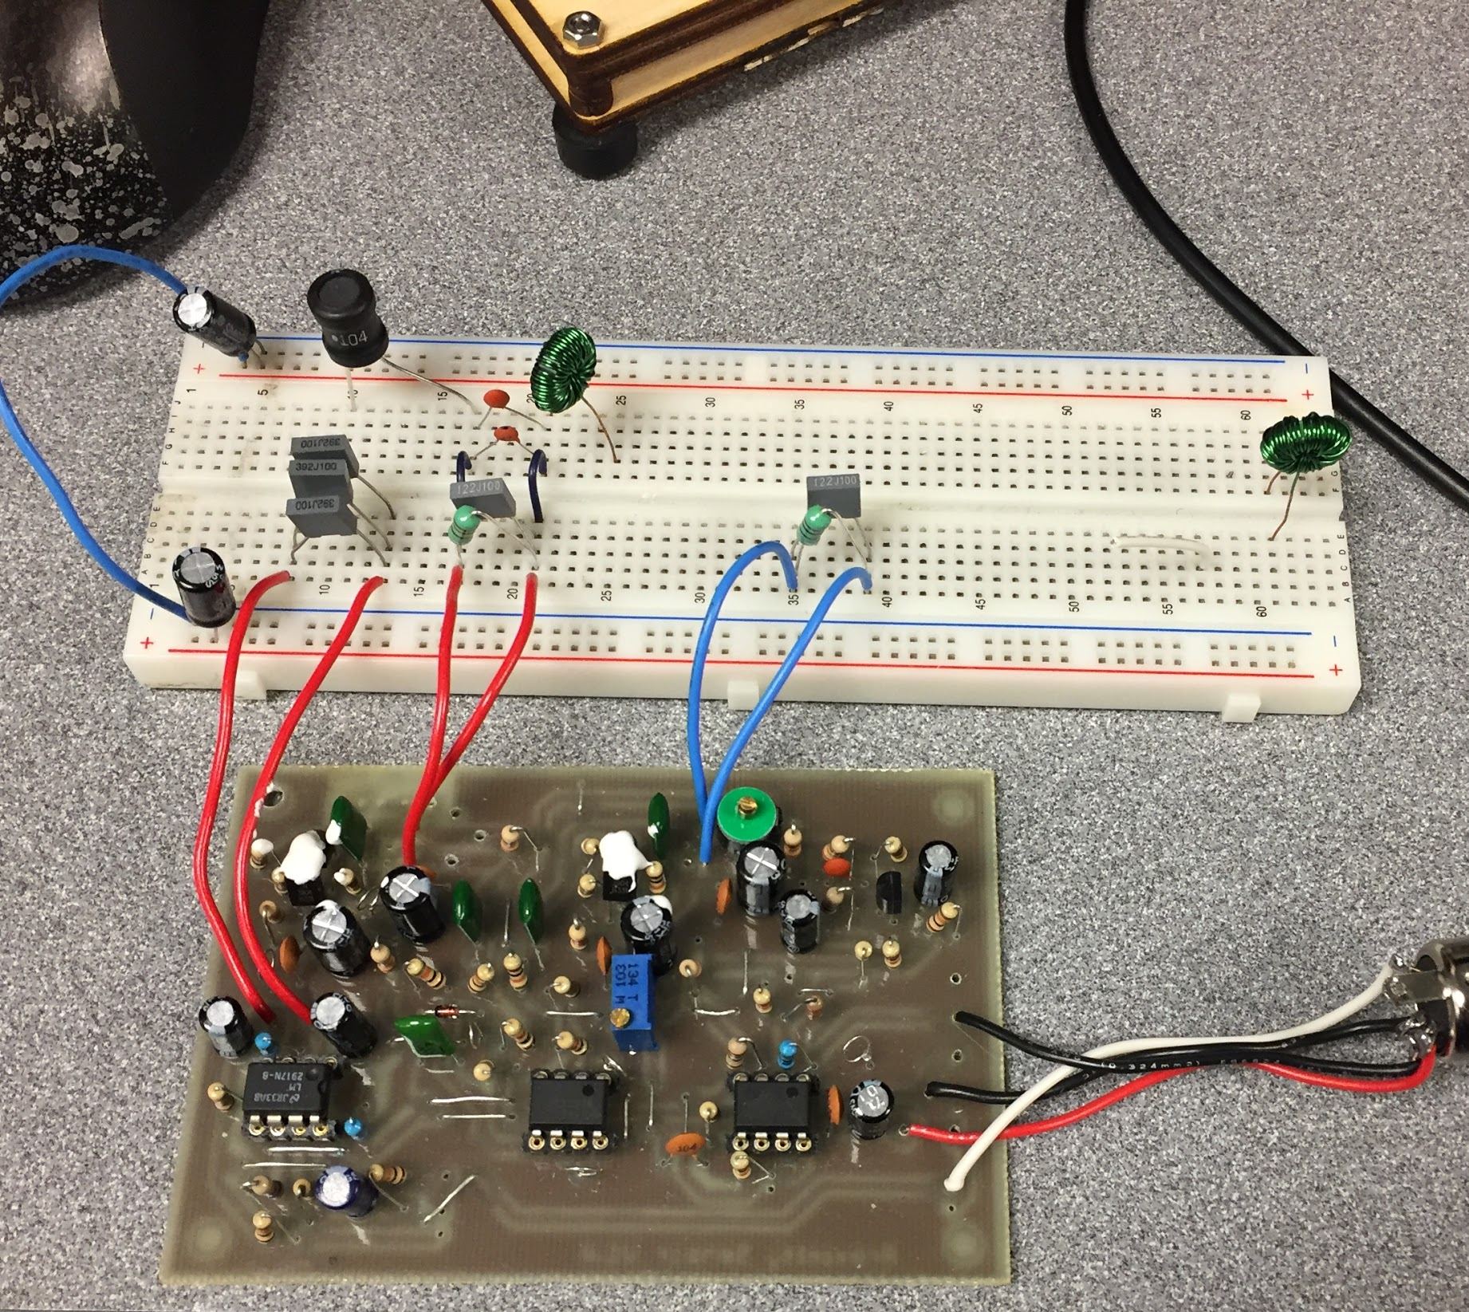
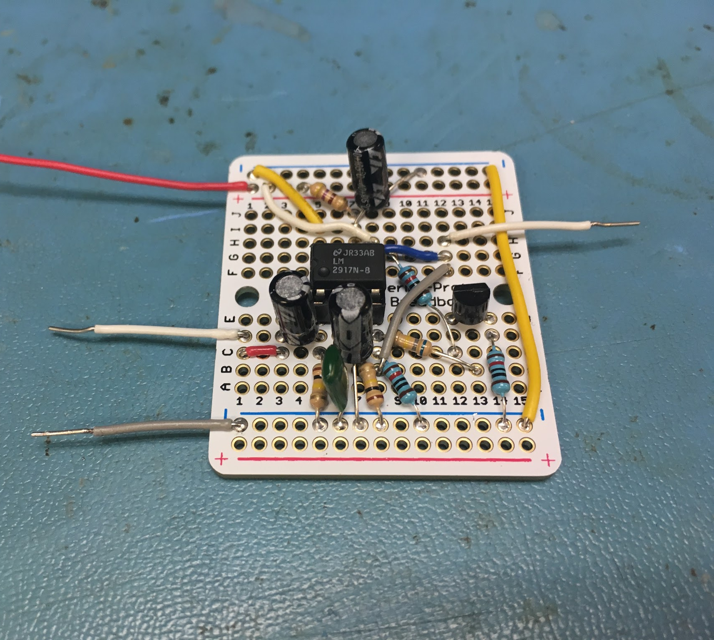
Prototyping Our Theremin Sensor Board

Slide 28
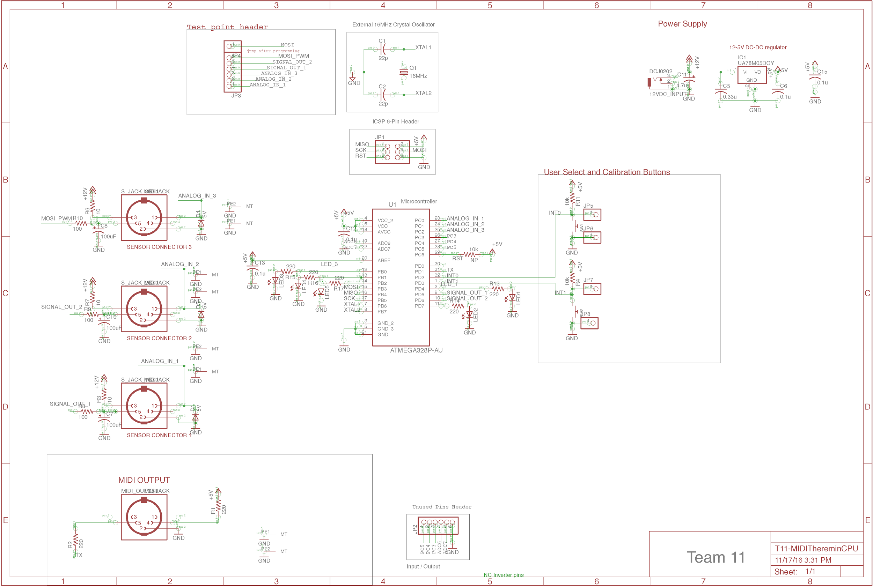

Slide 29
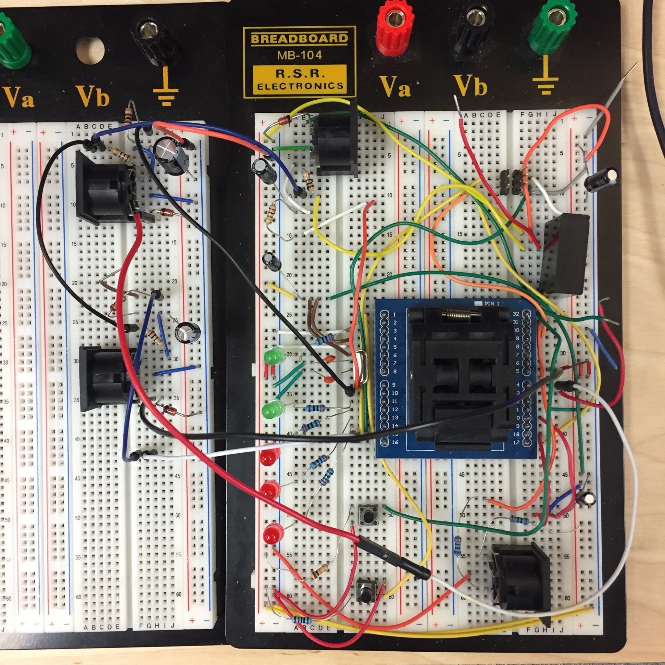
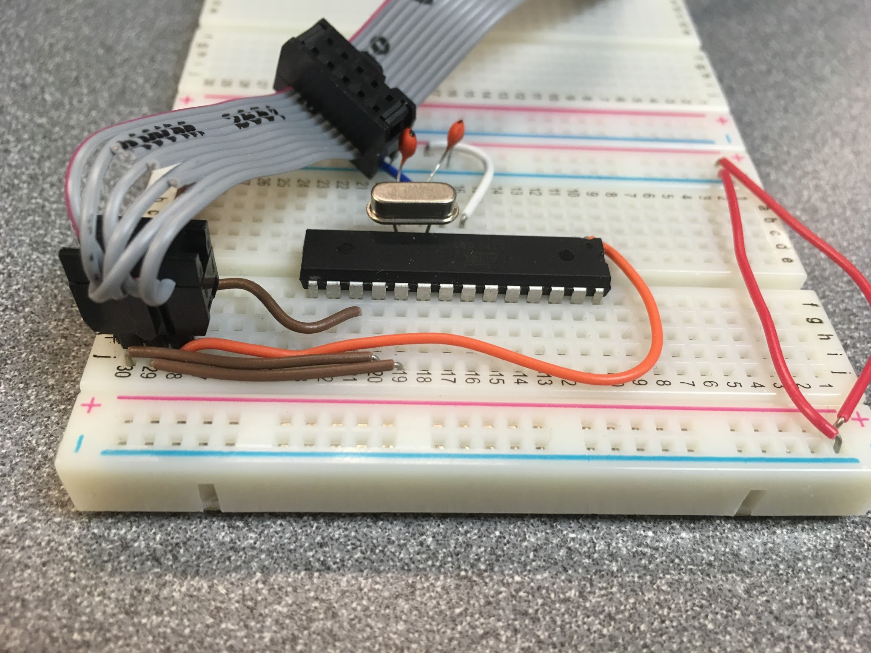
Prototyping our Sensor CPU Hub

Slide 30
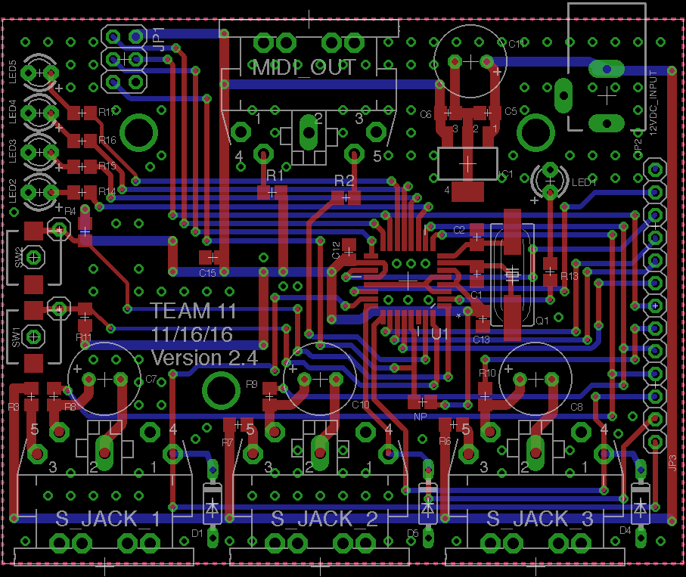
Notes:
Notice how this microcontroller board adheres to the single direction on a single layer convention.

Slide 31
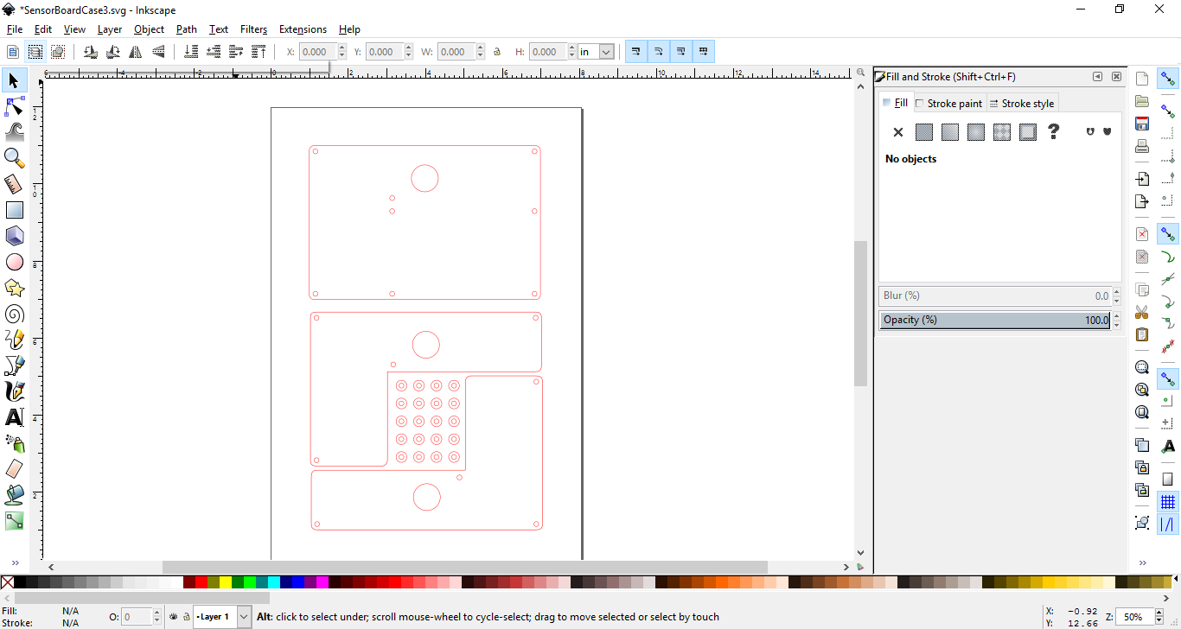
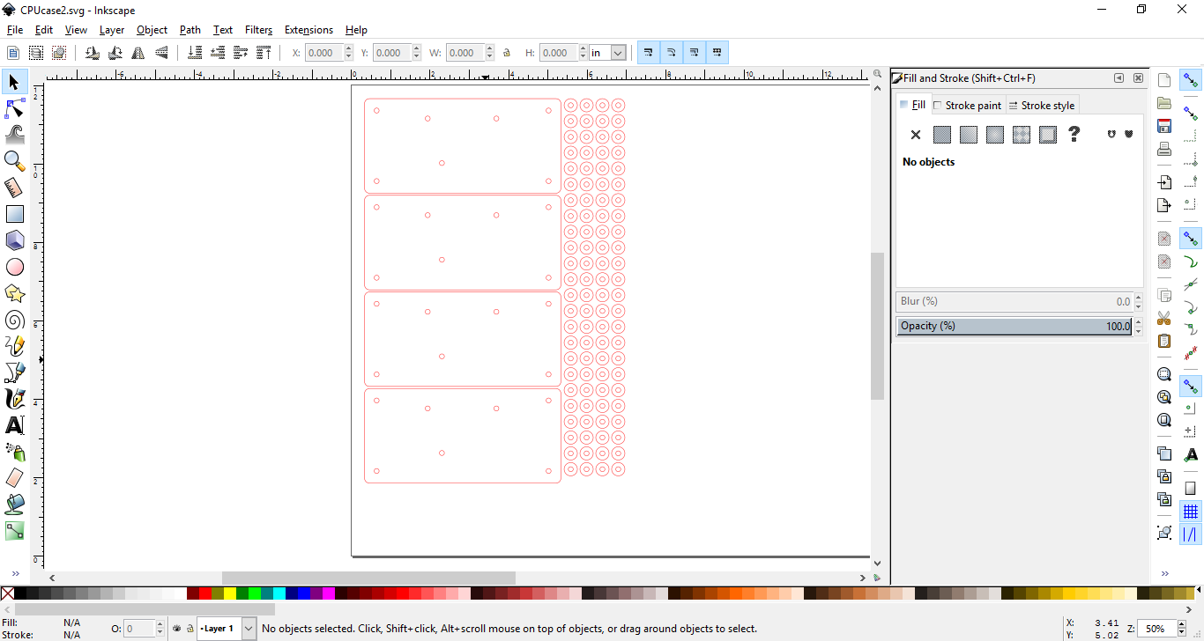
Case Design
For
Laser
Cutter
Notes:
Notice how this microcontroller board adheres to the single direction on a single layer convention.

Slide 32
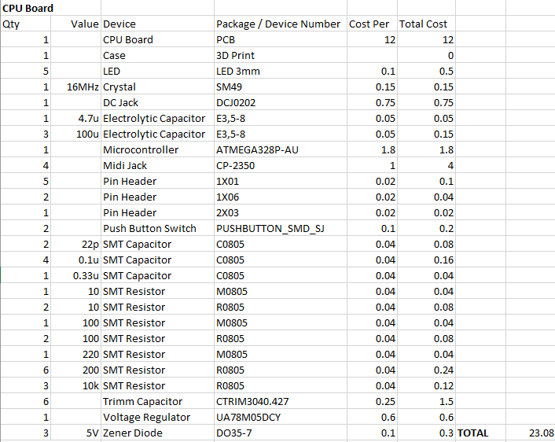
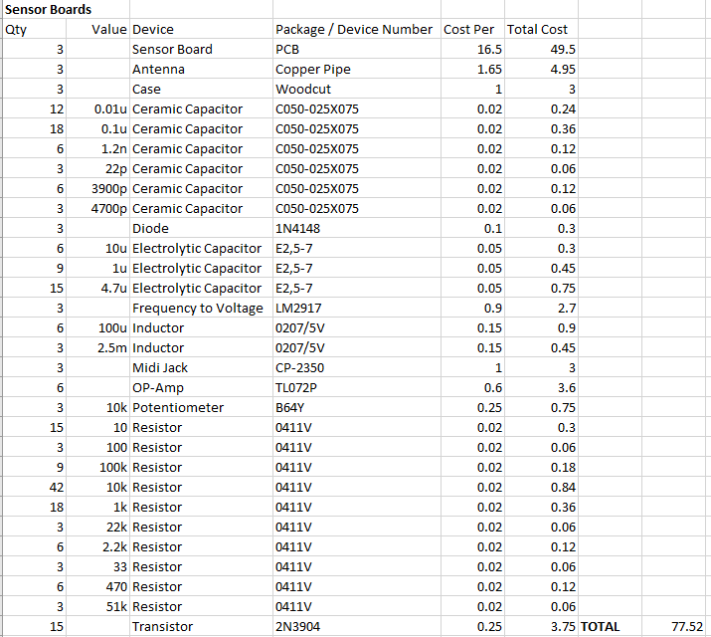
Bill of materials
Notes:
This is the bill of materials for 3 sensors and a single sensor hub

Slide 33
Test Plan
4. Functional Mode Checks
4.1 Mode 1
4.2 Mode 2
4.3 Mode 3
5. MIDI Control Checks
5.1 Mode 1
5.2 Mode 2
5.3 Mode 3
CPU Board Functional Checks
Power on indicator
Power supply voltages and current levels
Mode button and indicators
Sensor Board Functional Checks
Power supply voltages
Local oscillator accuracy
Pitch oscillator
Stable behavior
Detection range
Filter behavior
MISO voltage
Calibration Functionality Check
Run calibration function
Remeasure MISO

Slide 34
Summary of Resources
Hardware
Surface mount microcontroller breakout board
Usb to jtag programmer
Software
Eagle CAD
LT Spice
AVRDude
Intellectual Property
Build the EM Theremin- by Robert Moog
Arduino MIDI library

Slide 35
Contributions
Casey
Coil de-risking
Software programming
CPU hub prototyper
Analog Design
Charles
Analog design / Sensor board schematic
Sensor board PCB layout
Board layout supervisor
Sensor board assembly
Eric
Software programmer
Analog consultant
CPU board assembly
Atmega tool expert
James
Git repository supervisor
CPU Hub Schematic
CPU board PCB layout
Documentation writer

Slide 36
Lessons Learned
Hardware
Magnetic permeability of air isn’t that different from the magnetic permeability of your hand (water).
Nonlinear frequency to voltage converter
Software
More test points on CPU hub
A better debug set-up.
Communication
Getting block diagrams and I/O standards defined early.

